Slide 1
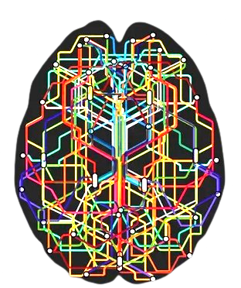
3D Brain Imaging
Kausthubh Reddy Eleti - 2297857
Nithin Kumar Balisetty - 2299352
Venkata Naga Sai Ram - 2299509

Slide 2
Problem statement
In the world of medical imaging, the visualization of Neuroimaging Informatics Technology Initiative (NIfTI) data plays an important role in gaining a detailed understanding of internal structures of brain, aiding in accurate diagnosis.
In our project, we aim to provide a GUI solution for visualizing both the brain and corresponding mask file which contains the information of different regions of interest i.e tumour regions etc that are obtained from the segmentation process.
The goal is to employ iso surfacing, slicing and projection techniques for visualizing the human brain and to label the different regions from the mask file with a discrete colormap.

Slide 3
Dataset
The database we used, titled "BraTS-TCGA-GBM," contains pre-operative multi-institutional scans of Glioblastoma Multiforme (GBM) from The Cancer Genome Atlas (TCGA) collection.
It provides both computer-aided and manually-corrected segmentation labels which gives the understanding of how the tumors are outlined along with multimodal MRI volumes, such as T1, T1-Gd, T2, and T2-FLAIR, in NIfTI format
Segment label files are considered as MASK files and the multimodal MRI volumes are treated as the patient’s Brain Data.
Link to the dataset : BraTS-TCGA-GBM

Slide 4
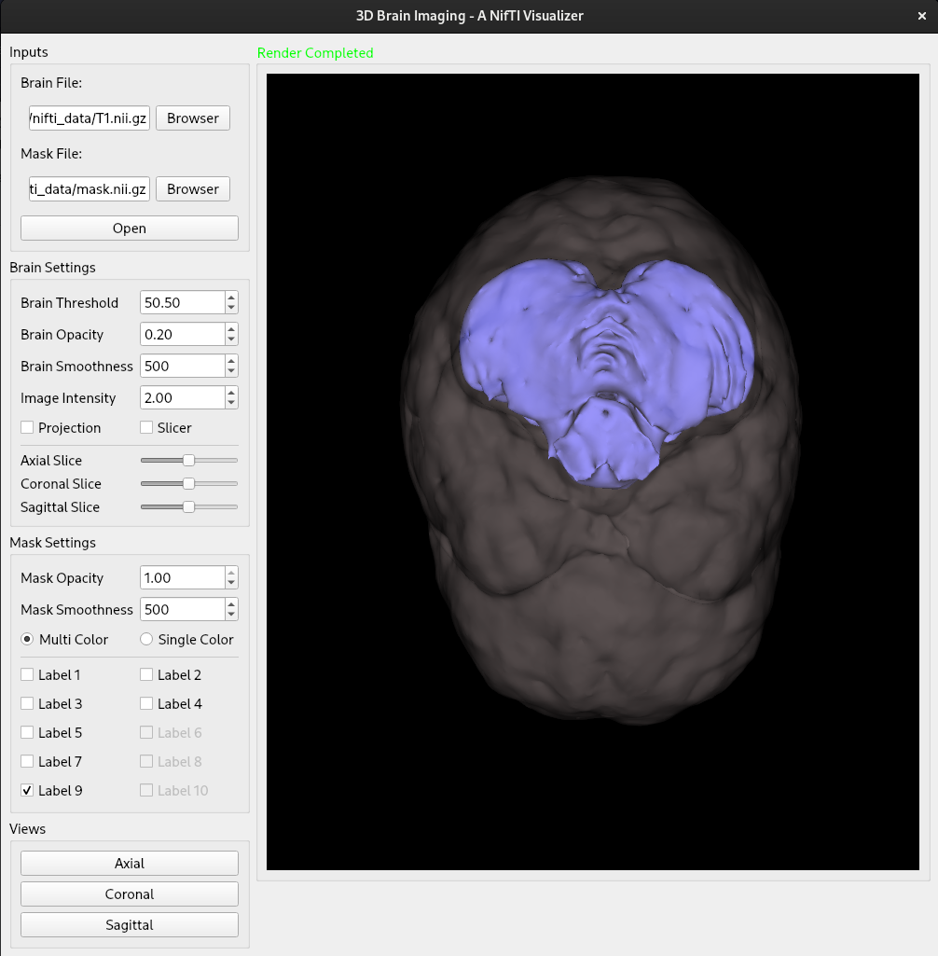
GUI Window
Browse and Load the files
Isosurface Threshold
Projection Technique
3D slicing Technique
Show regions of interest via labels
Display control of a label
Point of Views

Slide 5
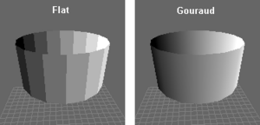
Iso Surfacing
Reading Volume (vtkNIFTIImageReader)
Data Extractor (vtkFlyingEdges3D)
Polygon Reducer (vtkDecimatePro)
Smoother (vtkSmoothPolyDataFilter)
Actor (vtkActor)
Mapper (PolyDataMapper)
Generating Normals (vtkPolyDataNormals)

Slide 6
Iso Surfacing
Reading Volume (vtkNIFTIImageReader)
Data Extractor (vtkFlyingEdges3D)
Polygon Reducer (vtkDecimatePro)
Smoother (vtkSmoothPolyDataFilter)
Actor (vtkActor)
Mapper (PolyDataMapper)
Generating Normals (vtkPolyDataNormals)
A highly scalable implementation used to generate isosurface from 3D image data

Slide 7
Iso Surfacing
Reading Volume (vtkNIFTIImageReader)
Data Extractor (vtkFlyingEdges3D)
Polygon Reducer (vtkDecimatePro)
Smoother (vtkSmoothPolyDataFilter)
Actor (vtkActor)
Mapper (PolyDataMapper)
Generating Normals (vtkPolyDataNormals)
Reduces the number of polygons (triangles) in the volume to speed up rendering.

Slide 8
Iso Surfacing
Reorients some points in the volume to smooth the render edges
Reading Volume (vtkNIFTIImageReader)
Data Extractor (vtkFlyingEdges3D)
Polygon Reducer (vtkDecimatePro)
Smoother (vtkSmoothPolyDataFilter)
Actor (vtkActor)
Mapper (PolyDataMapper)
Generating Normals (vtkPolyDataNormals)

Slide 9
Iso Surfacing
Reading Volume (vtkNIFTIImageReader)
Data Extractor (vtkFlyingEdges3D)
Polygon Reducer (vtkDecimatePro)
Smoother (vtkSmoothPolyDataFilter)
Actor (vtkActor)
Mapper (PolyDataMapper)
Generating Normals (vtkPolyDataNormals)
This filter will reorder polygons to insure consistent orientation across polygon neighbors

Slide 10
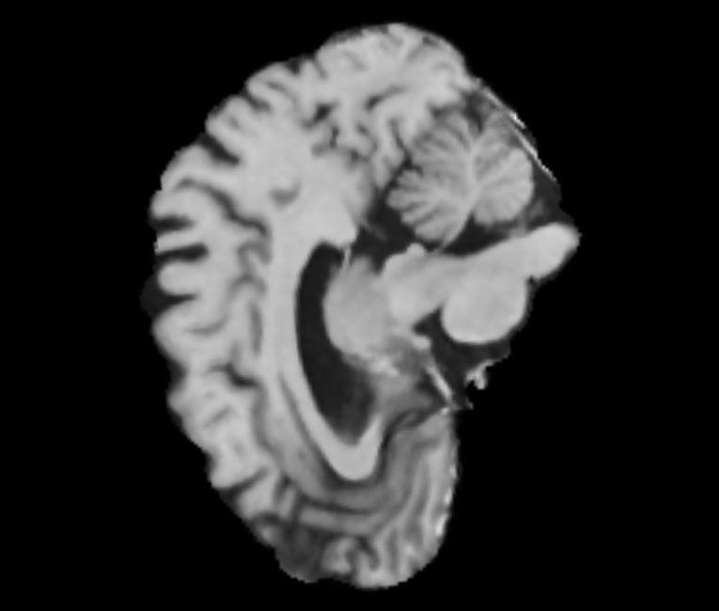
Projection Technique
Reading Volume (vtkNIFTIImageReader)
Create Lookup Table (vtkLookupTable)
Mapping Image on Screen (vtkImageResliceMapper)
Screening the image (vtkImageSlice)
Add ImageSlice object to render (AddViewProp)

Slide 11
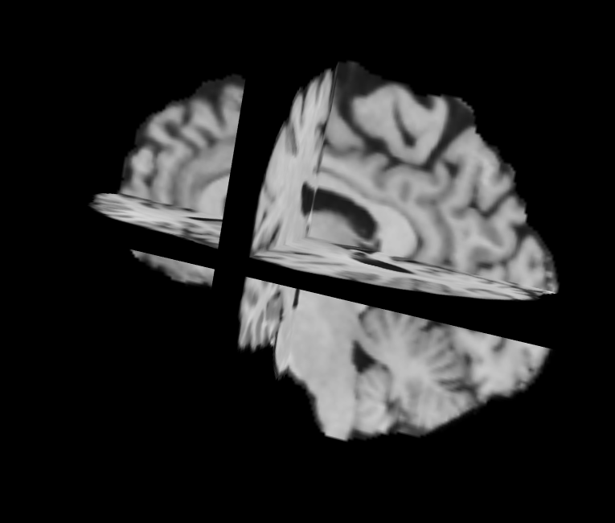
3D slicing Technique
Reading Volume (vtkNIFTIImageReader)
Create Lookup Table (vtkLookupTable)
Image mapper via Lookup Table (vtkImageMapToColors)
Mapper (PolyDataMapper)
Actor (vtkActor)
Control the index (SetDisplayExtent)

Slide 12
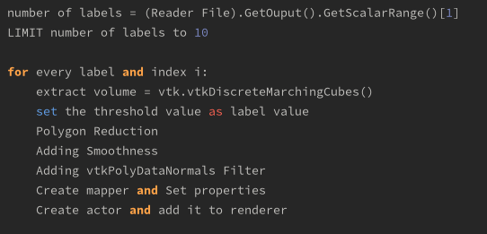
Visualising Different regions of Mask File
The volume enclosed in mask files consists of discrete integer values, typically obtained through segmentation processes
The objective is to generate an isosurface for each label, corresponding to each distinct region of interest within the mask file
The following code snippet is utilized to visualize all the regions of interest present in the mask file

Slide 13
Visualising Different regions of Mask File
Reading Volume (vtkNIFTIImageReader)
Data Extractor (vtkDiscreteMarchingCubes)
Polygon Reducer (vtkDecimatePro)
Smoother (vtkSmoothPolyDataFilter)
Actor (vtkActor)
Mapper (PolyDataMapper)
Generating Normals (vtkPolyDataNormals)
This algorithm is specialized for reading segmented volume labels

Slide 14
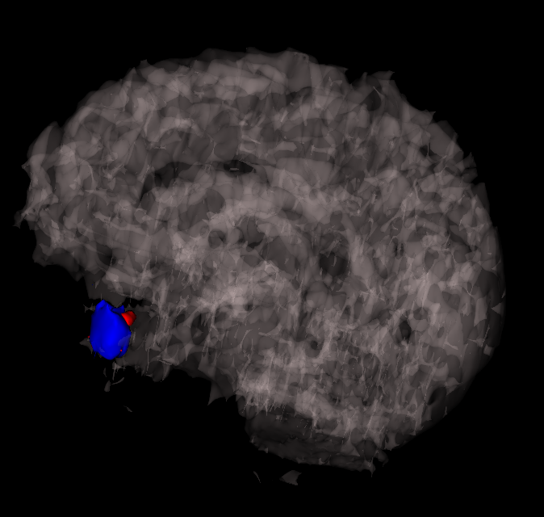
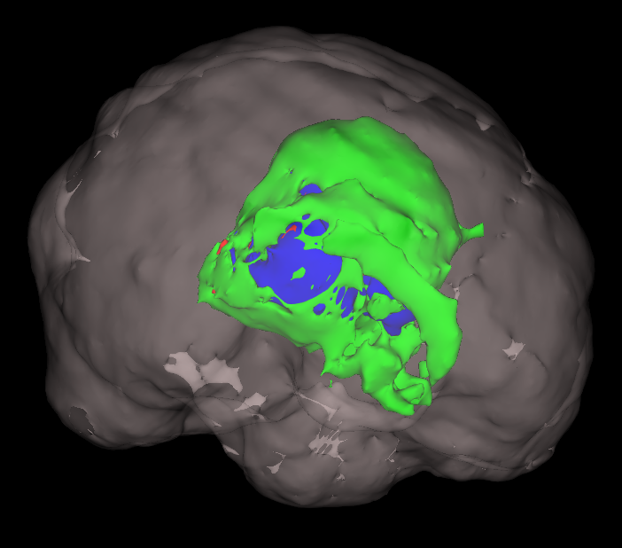
Visualising Different regions of Mask File
High Grade-Glioma Tumour region - Patient A
High Grade-Glioma Tumour region - Patient B

Slide 15
Future Scope
Extend support for visualizing multiple modalities of medical imaging data (e.g., incorporating PET, CT) to provide a more comprehensive view.
To implement volume rendering by incorporating more advanced transfer functions, shading techniques, or lighting effects to improve the visual representation and better diagnosis of brain structures
When dealing with large datasets, there can be further improvements in rendering speed, memory usage, and overall responsiveness if optimized filters and mappers can be used

Slide 16
Workload division
Nithin Kumar Balisetty
Implemented the visualisation of distinct boundaries of all possible regions of interest of tumour areas in the brain.
Kaustubh Reddy Eleti
Read the corresponding inputs using VTK file readers and implemented 3D slicing, projection features along with the design layout of the renderer window of VTK library.
Venkata Naga Sai Ram Nomula
Literature review to process the open-source NifTI data using Python and created the design layout of the render window of VTK library and documented the entire proceedings of the project.

Slide 17
Demo
Thank You!

